Slide 1
Assignment 2 - Biometrics based human identification
By Benjamin Walker & Sashinka Lintang
Student ID: 10273607 & 10483314
Lecturer: Dr. Syed Mohammed Shamsul Islam

Slide 2

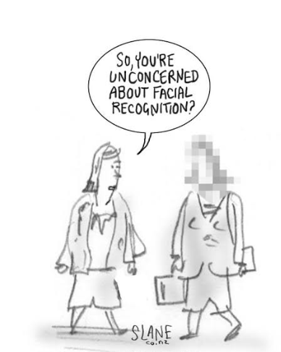
Overview
Objective: Identifying individuals through a facial recognition model and measure their threat level based on one of seven expressions
Expressions: Angry, Disgust, Fear, Happy, sad, Surprise, Neutral
Computer Vision (CV) with Deep-learning algorithm using Python Libraries
Dataset(s): Facial Expressions Recognition (2013) and small sub-set of individuals

Slide 3
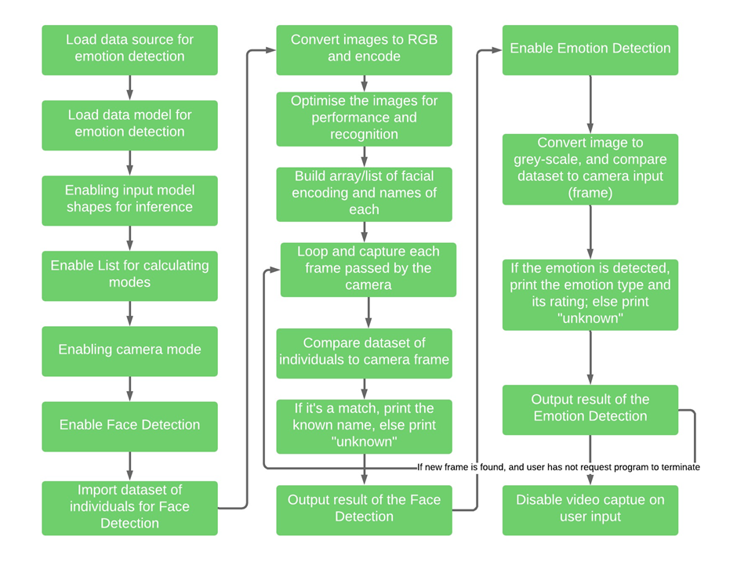
Implementation

Slide 4

Testing

Slide 5

Results

